Slide 1
Fundamentals of the Computer
By: Mrs. S. Palmer

Slide 2
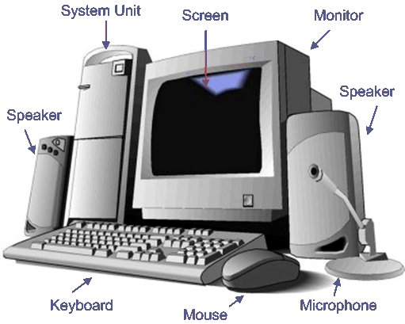
A Typical Computer
A typical computer is made up of the following parts; these are indicated by the arrows pointing on the devices.

Slide 3
Computer
Computers have become an indispensable tool and can be used to carry out an array of things. These include document preparation, research, communication among other things.

Slide 4
Advantages of the Computer
The advantages are:
Speed
Accuracy
Storage
Reliability

Slide 5
Speed
This refers to the acceleration of how fast the task is done on the computer.
Accuracy
This ensures that all work done on the computer is free of error.

Slide 6
Storage
This speaks to the large volume of viable space on the computer system that can store your work.
Reliability
People depend on the reliability of their computer system to ensure that their information is safe and accessible when they need it. The backup system means you can easily retrieve documents and data if you lose the originals.

Slide 7
Disadvantages of the Computer
The disadvantages are:
Change in human input
Unreliability
Poor health
Dependency

Slide 8
Change in human input
Some employees may lose their jobs where computers can complete tasks in less time and for less cost.
Unreliability
Some businesses cannot operate if the computer system breaks down or there is a power outage.

Slide 9
Poor health
Excessive or improper computer use can result in illness or injury
Dependency
People can become overly dependent on computers reducing the amount and quality of their interactions with family, friends and colleagues.

Slide 10
Components of a Computer System
These are:
- hardware
- software
- people
- procedure

Slide 11
Hardware
This refers to the tangible components of a computer system. For e.g; input devices, output devices, storage devices and processing devices.
Input, output and storage devices are also called peripheral devices. These are all connected to the system unit.
Software
This refers to the intangible components that cannot be touched. These are programs that tell the computer what to do and how to do it.

Slide 12
People
These refer to the users of the computer system.
Procedures
These are the instructions that tell a user how to operate and use the information system.

Slide 13
Data
This consists of raw facts such as numbers, letters, special characters or symbols that the computer can manipulate and store data in the form of coded electrical impulses called bits. A byte is the group of zeros and ones that represent one character. A byte is made up of 8 bits.

