Slide 1
Topic: Storage Devices
QUIZ
GRADE: 10

Slide 2
What is a Storage device?
A storage device is a hardware component that stores data, information and programming instructions.
Do you know what is meant by ‘programming instructions?’

Slide 3
Programming Instructions
These are software programs used by the computer; for example, Windows XP, Microsoft office word, excel and so on.

Slide 4
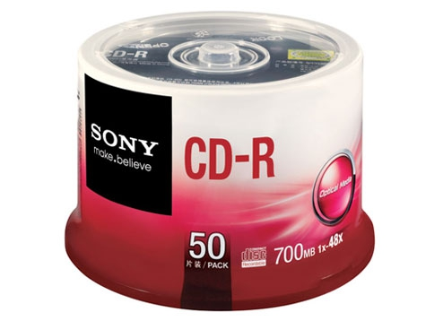
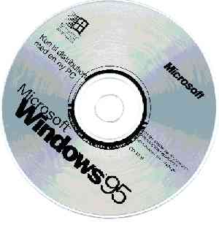
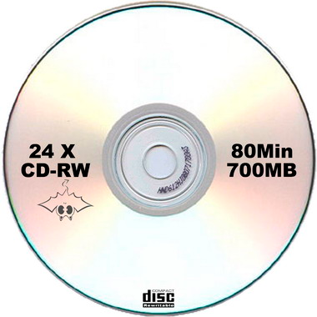
Can you identify the storage devices below?
Compact Disk-Read Only Memory
Compact Disk-Recordable
Compact Disk-Rewritable

Slide 5
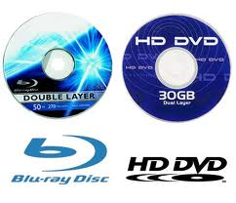
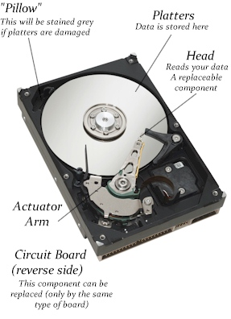
DVD – Digital Video Disk
Hard Disk
Flash Drive

Slide 6
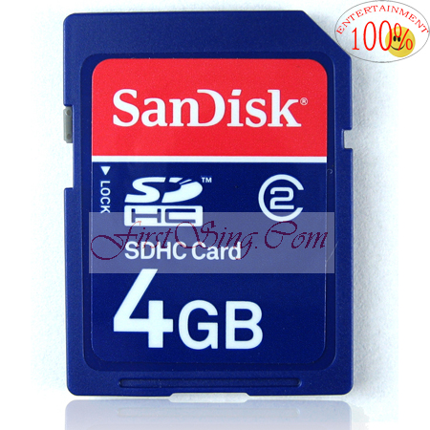
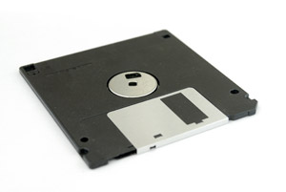
Memory Card
Floppy Disk

Slide 8
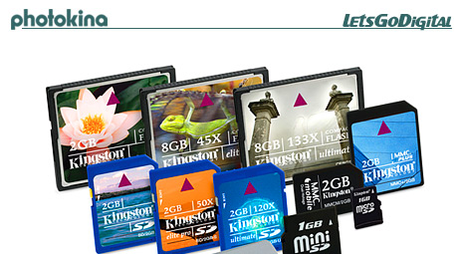
What storage device am I?
I am mostly found in cameras and many smart phones. I am built in many different sizes?
Answer:
Memory Card

Slide 9
What storage device am I?
They use me to back up data on hard drive but they mostly used me to store movies.
Answer:
DVD

Slide 10
What storage device am I?
When you add data to me, I am read only, meaning you can only read data but you cannot add or delete any data from me. I am mainly used to store computer software.
Answer:
CD-ROM

Slide 11
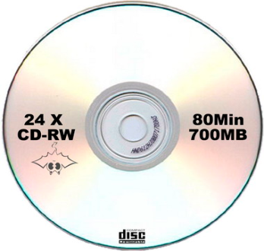
What storage device am I?
I am similar to a CD-ROM and CD-R. What makes me different is the fact that you can write (add) data to me more than one time. They store a lot of data on me.
Answer:
CD-RW

Slide 12
What storage device am I?
They always burn me to add their favourite music. They can only add data to me once.
Answer:
CD-R

Slide 13
What storage device am I?
Nobody seem to use me anymore because I store the smallest amount of data.
Answer:
Floppy Disk

Slide 14
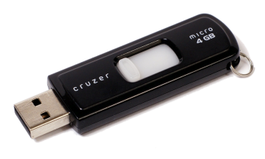
What storage device am I?
I am the most popular guy in town. I am a small light and portable fellow, in that they carry me in their pockets and even wear me around their necks. I come in various shapes and sizes.
Answer:
Flash Drive

Slide 15
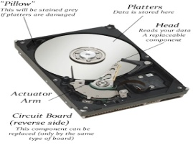
What storage device am I?
I am the computer’s main secondary storage. I store a lot of data and information. You can’t see me because I always stay inside the System Unit.
Answer:
Hard Drive

Slide 16
Question 1
The Administrative Office of the University College of the Caribbean processes thousands of students’ data on a daily basis. The supervisor is now concerned of the limited amount of storage space available on the hard drive, which is the main storage device for the computer system.

Slide 17
Suggest ONE suitable device identified above that the University College could use to ease this problem. Give reasons for your answer.

Slide 18
Questions:
1. In what ways can the CD-R, CD-ROM, Memory Card and DVD be used in an office environment?
2. What is the difference between a CD- ROM, and CD-RW.

Slide 19
Did You Enjoy
This Lesson?

Slide 20
Goodbye!
See you next week!

