Slide 1
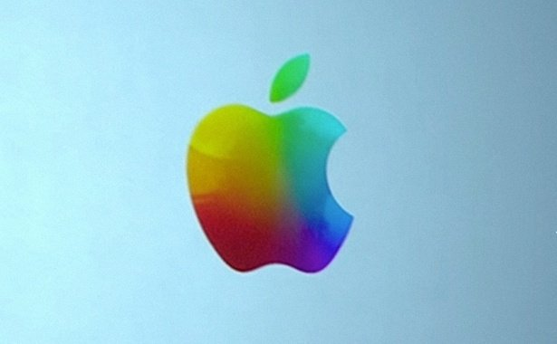
Information Technology
What we need to know about Computers

Slide 2
What is Computer
A computer is an electronic device that manipulates information, or "data." It has the ability to store, retrieve, and process data. You can use a computer to type documents, send email, and browse the internet. You can also use it to handle spreadsheets, accounting, database management, presentations, games, and more.

Slide 3
Types of Computers
There are four different types of computers when we classify them based on their performance and capacity. The four types are:
Super Computers
Mainframe Computers
Mini Computers
Micro Computers

Slide 4
Super Computers
A supercomputer is a computer at the frontline of current processing capacity, particularly speed of calculation.

Slide 5
Super Computers

Slide 6
Mainframe Computers
A mainframe computer is used by the government or other big organizations to organize information systematically. This maybe used for transactions, weather forecasting and mission critical applications such as NASA computers. Incase of power-cuts mainframe computers will have a backup battery that will run for a few minutes before allowing a generator to take over.
Mainframe computers are also the oldest type of computer, uses are never taken away from mainframe computers, they are added.

Slide 7
Mainframe Computers

Slide 8
Mini Computers
Mini computers are lower to mainframe computers in terms of speed and storage capacity. They are also less expensive than mainframe computers. Some of the features of mainframes will not be available in mini computers. Hence, their performance also will be less than that of mainframes.

Slide 9
Mini Computers

Slide 10
Micro Computers
The invention of microprocessor (single chip CPU) gave birth to the much cheaper micro computers. They are further classified into
Desktop Computers
Laptop Computers
Handheld Computers(PDAs)

Slide 11
Desktop Computers
Today the Desktop computers are the most popular computer systems. These desktop computers are also known as personal computers or simply PCs. They are usually easier to use and more affordable. They are normally intended for individual users for their word processing and other small application requirements.

Slide 12
Desktop Computers

Slide 13
Laptop Computers
Laptop computers are portable computers. They are lightweight computers with a thin screen. They are also called as notebook computers because of their small size. They can operate on batteries and hence are very popular with travelers. The screen folds down onto the keyboard when not in use.

Slide 14
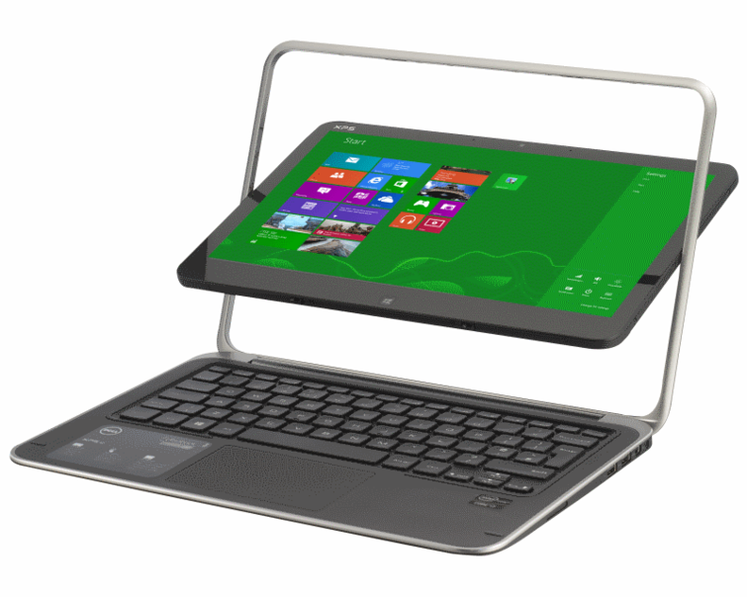
Laptop Computers

Slide 15
Handheld Computers
Handheld computers are pen-based and also battery-powered. They are small and can be carried anywhere. They use a pen like stylus and accept handwritten input directly on the screen. They are not as powerful as desktops or laptops but they are used for scheduling appointments, storing addresses and playing games. They have touch screens which we use with a finger or a stylus

Slide 16
Handheld Computers

Slide 17
The End

